Slide 1
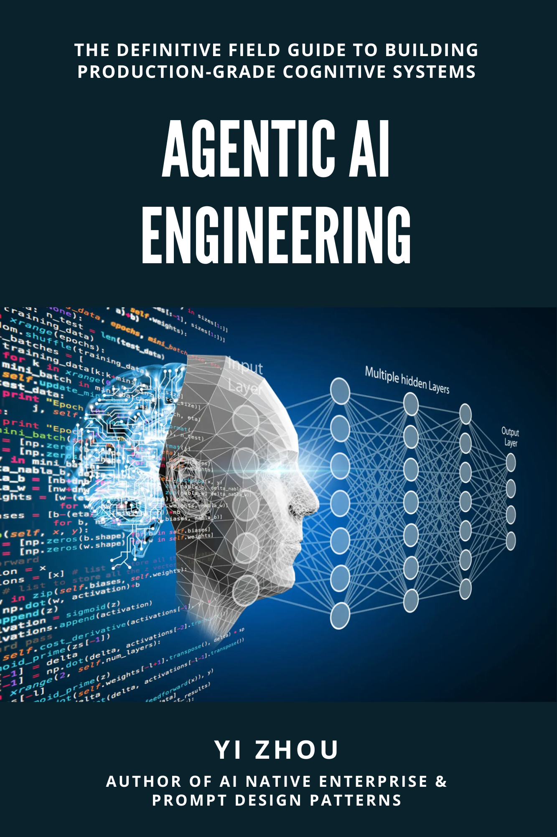
Agentic Engineering for developers
Vivek Rawat
May 2026

Slide 2
Before We Dive In
What's the difference between using AI and engineering with AI?
Why you have 2 projects for which AI is generating code differently?
What goes wrong when we plug AI in without redesigning around it?

Slide 3
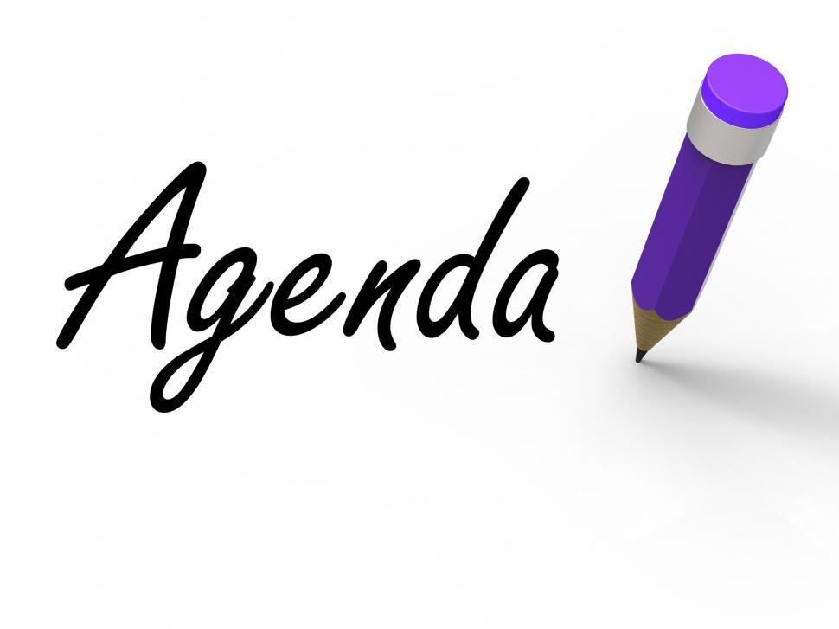
Agenda
Why Now?
Why Agentic Engineering?
What is Agentic Engineering?
Mindset Migration
Agentic development workflow – User Story
Agentic development workflow – Architecture
Evaluations
Q & A

Slide 4
Why now?
Why Now?
Argue is not about AI is coming – that fight is over.
The Capacity shift (What changed):
LLMs crossed from autocomplete to autonomous task completion in 2024–2025.
Hour-long software tasks: ~5% success in late 2023 → over 40% in 2025.
Anthropic reports 70–90% of code is now AI-written; some engineers ship 20+ PRs/day, all agent-authored.
~25–30% at Microsoft, Google, Salesforce — and climbing.
The cost of getting it wrong is real: AWS Cost Explorer 13-hr outage and ~6.3M lost Amazon orders linked to Gen-AI assisted code changes (Dec 2025–Mar 2026)
Notes:
Pitch: Companies treating AI as "give engineers Copilot and hope for best"
The Capacity shift (What changed): Past AI coding = suggestions a human accepts/rejects. New AI coding = systems that finish work.
Bigger autonomy, bigger explosion.
The Mechanism (How it changed):
Tool use, long context, and reasoning models combine to finish multi-step work end to end
The upside = the numbers above. 40% hour-long task success, 70–90% AI-written code at Anthropic, 20+ PRs/day per engineer. That's the prize.
The blast radius = the Amazon line. When an agent has production access and gets a multi-step task wrong, the failure mode isn't a typo — it's a 13-hour outage or 6.3M lost orders.
Agentic engineering = the discipline that lets you keep the first without paying the second. Not "use AI more" or "use AI less" — it's the practices that make autonomous agents safe to deploy: scoped permissions, human-in-the-loop gates for destructive ops, tight task specs, evals, observability, rollback plans.

Slide 5
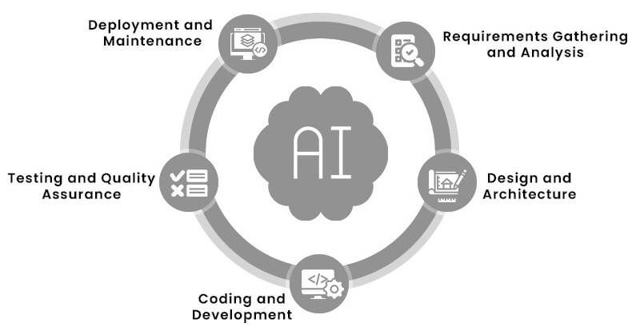
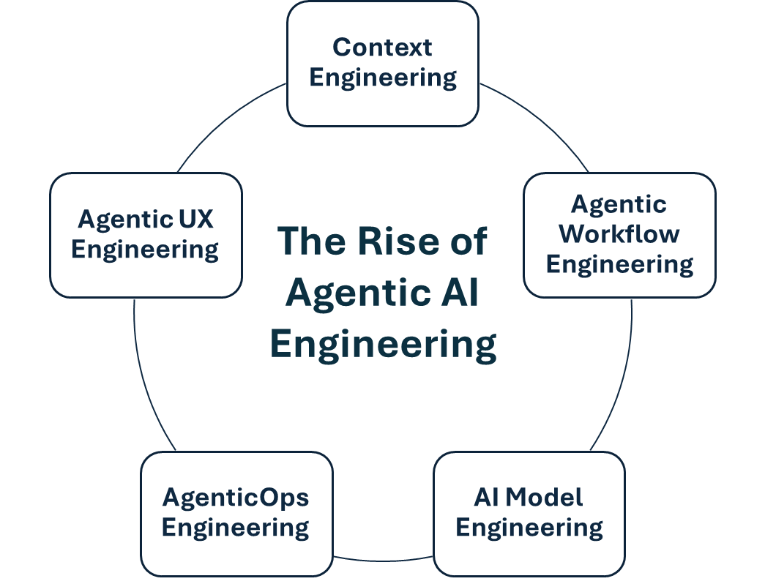
SDLC
Agentic Engineering disciplines
Feeding AI the right information at the right time.
Designing how humans interact with and trust autonomous agents.
SDLC with AI
Designing how the AI sequences tasks and makes decisions.
Define
Spec
Code
Verify
Plan
Running agents reliably in production — the "DevOps" of AI agents.
Selecting, fine-tuning, and optimizing the underlying models.
Validate
Think before doing
Execute

Slide 6
Why we need Agentic engineering?
Three failure modes
Principles to follow
Silent Assumptions
Think Before Coding
1
The model makes wrong assumptions on your behalf and just run along with them without checking.
1
Don't assume. Don't hide confusion. Surface tradeoffs.
Overcomplication
Simplicity First
2
The model implement a bloated code of 100 lines when 10 would do.
2
Minimum code that solves the problem. Nothing speculative.
Side-Effect Edits
Surgical Changes
3
Model still sometimes change/remove comments and code they don’t fully understand.
3
Touch only what you must. Clean up only your own mess.
Goal-Driven Execution
3
Define success criteria. Loop until verified.
Notes:
Models do not manage their confusion, don’t seek clarifications, don’t present inconsistencies, tradeoffs and don’t pushback when they should.
Transform imperative tasks into verifiable goals:
Instead of... Transform to...
"Add validation“ "Write tests for invalid inputs, then make them pass“
"Fix the bug“ "Write a test that reproduces it, then make it pass“
"Refactor X“ "Ensure tests pass before and after"

Slide 7
What is Agentic Engineering?
Agentic engineering is the discipline of building software with autonomous AI agents as collaborators
— not just using AI as a smarter autocomplete.
The shift in what "engineering" means
Traditional software engineering: A human writes code, Tools assist with syntax, tests & deployment.
AI-assisted engineering (Copilot era): A human writes code, AI suggests the next line or function, The human accepts or rejects.
Agentic engineering: A human defines the goal and constraints. An AI agent plans, writes, runs, tests, and iterates on multi-step work autonomously. The human reviews and approves outcomes. The unit of work shifts from "lines of code" to "tasks completed."
Using AI: The engineer writes code faster.
Agentic engineering: The engineer designs a system in which agents write code reliably.
Notes:
The term “Engineering” draws a deliberate line between "we have Copilot" and "we've thought about how AI agents fit into our SDLC, our permissions model, our review process, and our incident response.“

Slide 8
Why it's "engineering?
The developer's role has shifted from author to operator and reviewer.
Task specification — writing prompts and contexts the agent can succeed against
Tooling — building the file access, command execution, test runners, and observability the agent uses
Permissions and sandboxing — scoping what the agent can touch (read-only vs. write, dev vs. prod)
Human-in-the-loop gates — deciding what requires review (every PR? destructive ops? schema changes?)
Evals and observability — measuring where the agent succeeds and fails, iterating like you would on any production system
Rollback and recovery — assuming the agent will be wrong sometimes, and designing for graceful failure
Discipline is everything around the agent.
Notes:
The term “Engineering” draws a deliberate line between "we have Copilot" and "we've thought about how AI agents fit into our SDLC, our permissions model, our review process, and our incident response.“

Slide 9
Mindset Migration
The job isn't writing code anymore.
It's engineering a system that produces code reliably — and you're the one running it.
The Coder
The Director
Writes lines of code Accepts AI suggestions Measured by output volume
Specifies goals & constraints Reviews agent outcomes Measured by tasks shipped

Slide 10
Mindset Migration - Why this is genuinely hard?
Loss of the dopamine loop:
Writing code is satisfying. You see progress with every keystroke.
Reviewing AI output is slower-feeling, even when it's faster in wall-clock terms.
Identity threat:
"I'm a coder" is many engineers' professional identity.
Becoming someone who directs coders (even AI ones) feels like demotion or detachment, especially early on.
The verification trap:
It's tempting to just trust the output because reading it carefully is tedious.
Verification is the job now — and the engineers who skip it ship the bugs.
Specification is harder than coding:
Most "I can't get the AI to do this" complaints are actually "I haven't specified what I want.“
Writing a clear spec that an agent can execute reveals every ambiguity in your own thinking.
Senior engineers ship 2.5× more AI code than juniors — not because they're faster typists, but because they catch mistakes faster. The skill that matters is judgment, not generation.

Slide 11
Mindset Migration – The big 5
A. From "writing code" → "specifying outcomes"
Stop thinking about how the code should be written. Start thinking about what done looks like: inputs, outputs, edge cases, constraints, tests that must pass. The clearer your spec, the better the agent performs. Vague spec → vague result. This is closer to writing a bug ticket than writing code.
B. From "trusting your fingers" → "trusting your review"
You can no longer trust that code is correct because you wrote it. The agent wrote it. Your typing-time has moved to reading-time. Review every diff with the same skepticism you'd apply to a junior's PR — even when (especially when) it looks plausible. Confident-sounding wrong answers are the most dangerous output.
C. From "one task at a time" → "supervising parallel work"
A coder works on one thing. A director can have 3–5 agents running in parallel — one refactoring, one writing tests, one drafting docs. The bottleneck shifts from typing speed to attention bandwidth. New skill: knowing what to delegate, what to do yourself, and when to interrupt an agent that's going off-track.
D. From "AI as autocomplete" → "AI as a teammate with limits"
A teammate has strengths, weaknesses, and predictable failure modes. You learn theirs and you scope work to fit. Agents are the same: great at boilerplate, refactors, well-defined tasks; weak at architectural decisions, ambiguous requirements, novel domains. Knowing the boundary is the skill.
E. From "owning the code" → "owning the system"
You're still accountable for what ships — the agent isn't. But what you own has shifted up a level: the prompts, the tools the agent has access to, the review gates, the eval suite, the rollback plan. You're now the engineer of the system that produces code, not the producer of code itself.

Slide 12
Mindset Migration – New role
A senior engineer's day used to be ~70% writing code, 30% everything else.
In an agentic workflow it inverts:
20% writing code — the parts that genuinely require human judgment
30% writing specs and prompts — describing tasks crisply enough that agents can execute
30% reviewing agent output — reading diffs, running tests, catching mistakes
20% systems work — improving prompts, tools, evals, guardrails so future tasks go smoother
The work shifts from production to direction and curation
You know an engineer (or team) has migrated, when:
They write a one-paragraph spec before launching an agent — every time.
They review every diff before merging, no matter how confident the agent sounds.
They can articulate, for any task, why it should or shouldn't be delegated to an agent.
They invest time improving their prompts and tools, not just using them.
They measure themselves on tasks shipped, not lines written.
They feel less productive but ship more.

Slide 13
Agentic Development workflow
Define: Write the intent and acceptance criteria before prompting.
Spec
Code
Verify
Plan
Validate: Tests, evals, and a human gate before merge.
Think before doing: Agent proposes an approach. Human reviews before execution.
Execute: Agent executes with small diffs and frequent commits.

Slide 14
Agentic Development Workflow - Specifications
Specs are the new source code.
What is a Spec?
This is the "what" phase — the AI analyzes the task and defines what needs to be built.
Understands the requirements from your prompt
Identifies edge cases, constraints, and dependencies
Clarifies ambiguities before writing any code
Produces a clear definition of the problem to solve
Specs require knowing the codebase, not just the task.
Notes:
The clearer your spec, the better your agent — and the skill that distinguishes a director from a coder is knowing how to write one.

Slide 15
Agentic Development Workflow - Specifications
The anatomy of a good spec
Every spec regardless of length, answers 6 questions:
1. Goal — what outcome are we producing?
Not "fix the bug" but "the checkout API should return 400 with {error: 'missing_email'} when called without an email field."
2. Context — what does the agent need to know?
Relevant files, prior decisions, conventions, related code, the architecture it's working inside. This is where most specs fail — engineers assume the agent shares their mental model.
3. Constraints — what must be true of the solution?
"Don't change the database schema." "Stay within the existing auth middleware." "Match the style of services/payments/*." Negative space matters as much as positive instruction.
4. Non-goals — what is explicitly out of scope?
"Don't refactor the surrounding code." "Don't add new dependencies." "Don't touch the test infrastructure." Without these, agents tend to over-deliver.
5. Acceptance criteria — how will we know it's done?
Concrete, checkable, ideally automated: "All existing tests pass. New test added for the missing-email case. npm run lint clean. Diff under 50 lines."
6. Interfaces — what's the shape of inputs and outputs?
Function signatures, API contracts, data schemas. The places where the new code touches existing code are where specs need to be tightest.

Slide 16
Agentic Development Workflow - Specifications
Examples of Spec quality:
Same task, three spec qualities:
❌ Bad spec (chat-window prompt):
"Add input validation to the checkout endpoint.“
→ Agent guesses what to validate, where to add it, what error format to return, whether to add tests. You get something that compiles and probably ships a bug.
🟡 Okay spec:
"In routes/checkout.ts, add validation for required fields: email, items, shipping_address. Return 400 if missing.“
→ Agent knows what to validate. Still guesses error format, test approach, whether to extract a helper. Output is plausible but inconsistent with the codebase.
✅ Good spec:
Goal: Validate required fields on POST /checkout before hitting the payment processor.
Context: Endpoint lives in routes/checkout.ts. Existing pattern in routes/orders.ts:42 shows the validation style we use (assertRequired helper from lib/validators).
Constraints: Use the existing assertRequired helper. Match the error response shape from orders.ts. No new dependencies.
Non-goals: Don't refactor the route handler. Don't add validation for optional fields.
Acceptance: Returns 400 {error: 'missing_field', field: '...'} for missing email/items/shipping_address. Existing checkout tests still pass. New test case for each missing field. Diff under ~40 lines.
→ Agent produces the right code on the first try. You review a small, clean diff against criteria you wrote.

Slide 17
Agentic Development Workflow - Specifications
Spec patterns:
Spec templates: A team-shared markdown template with the six anatomy fields. Reduces missed sections, shortens authoring time.
Spec-then-code: The spec gets reviewed by a teammate (or a meta-agent) before execution. Catches ambiguity early.
Spec lives in the PR: The final PR description is the spec. Reviewers verify code-vs-spec instead of code-vs-vibes.
Spec libraries: Reusable spec fragments for common patterns — "add a feature flag," "introduce a new endpoint," "migrate a query." Stops engineers re-inventing the wheel.
Spec evals: Run the same spec across multiple models or prompts to see which produces better output. The spec is the fixed input; the output is what's measured.

Slide 18
Agentic Development Workflow - Planning
This is the "how" phase — the AI lays out a step-by-step approach to implement the spec.
Breaks the work into concrete steps or subtasks
Identifies which files to create or modify
Decides on architecture, patterns, and tools to use
Sequences the work in a logical order before executing
Having the AI spec and plan before coding leads to:
Fewer mistakes — problems are caught before code is written
Better structure — the solution is thought through holistically
More predictable output — you can review and correct the plan early
Less wasted work — avoids going down the wrong path
Prompt: Before writing any code, spec out what needs to be built and create a plan.

Slide 19
Agentic Development Workflow
User Story

Slide 20
Agentic Development Workflow – User Story Planning & Specs
Core Spec (What) Artifacts
Functional Specification
UX/Interaction Specification
Data Specification
API / Interface Specification
Edge Case + Error State Catalog
Non-Functional Requirements
Acceptance Criteria (detailed)
Core Planning (How) Artifacts
Problem Statement
User Personas
Feature List (prioritized)
User Story Map
Release Plan / Milestone breakdown
Assumptions + Risks log

Slide 21
Agentic Development Workflow – Example Prompts for User Story
Planning for user stories:
For user stories, you want AI Agent to be thorough about product and user thinking.
User Story Creation Prompts
Before writing this user story, identify:
Who specifically is the user (role, context, technical level)
What job are they trying to accomplish
What pain does this solve or value does it deliver
What assumptions are we making about their context
Write this user story in the format:
"As a [specific persona], I want to [action], so that [outcome].“
Then challenge your own story: does the outcome actually follow from the action?
List every assumption baked into this user story.
Flag which ones are unverified by user research or product data.
Acceptance Criteria Prompts
Write acceptance criteria for this story that are:
Testable (pass/fail, not subjective)
Written from the user's perspective, not the system’s
Covering the happy path, at least two edge cases, and at least one error state
For each acceptance criterion, write a one-line test description that a QA engineer could execute without asking any clarifying questions.
What is explicitly out of scope for this story?
List at least three things that could reasonably be assumed in scope but aren't.
Dependency and Risk Prompts
What does this story depend on — other stories, systems, APIs, team decisions?
What stories or work does this story block?
Flag any circular dependencies.
What is the most likely way this story gets mis implemented?
What ambiguity in the current wording would lead a developer in the wrong direction?
Run a pre-mortem on this story: it's shipped and users hate it or it caused a bug.
What went wrong, and does the current story wording prevent that?
Refinement and Clarity Prompts
A developer is picking this story up cold with no context.
What will confuse them? What implicit knowledge does this story assume?
Rewrite to make it self-contained.
Does this story encode any irreversible product decisions —data structures, public-facing behavior, user-visible contracts?
Flag them for explicit review before development starts.
Split this story into: must-have for launch, should-have, and nice-to-have.
If everything is must-have, challenge that assumption.

Slide 22
Agentic Development Workflow – Implementation planning
Before starting implementation…
"Think through this design carefully. Give me a numbered decision log covering: what you'll build, what you won't build, assumptions you're making, and alternatives you considered.
Lay out your full design plan: components, data flow, file structure, key decisions and tradeoffs. Wait for my approval before implementing.“
The "alternatives you considered" part forces genuine reasoning rather than just restating the task back to you.
The "wait for my approval" part is critical — without it, Claude Code will often outline and then immediately start coding in the same response.
or add below in claude.md file
## Workflow Rules
For any non-trivial task, produce a design plan first
Include: A numbered decision log covering: In scope, Out of scope, assumptions, and alternatives
Include: file structure, component breakdown, data flow, key decisions, alternatives you considered
Do not write implementation code until the plan is explicitly approved

Slide 23
Agentic Development Workflow – Example with Claude.md
# Planning and Spec Protocol
## Planning Phase
###When to run planning
Run planning when: starting a new feature, epic, or product area.
Do not start spec work until planning artifacts are approved.
### Required planning artifacts
Problem statement — measurable outcomes only, no vague language
Personas — specific enough to make design decisions from
Prioritized feature list — MoSCoW with documented rationale
User story map — activity > task > story hierarchy
Release plan — MVP / V1 / V2 with milestone outcomes defined
Assumption log — verified vs unverified flagged
Risk log — probability + impact matrix, H/H items escalated
Dependency log — external blockers identified
### Planning rules
Every outcome must be observable and measurable
Every Must Have must justify why it blocks the release
Every Won't Have must be documented to prevent relitigating
Story map must tell a coherent user journey narrative
No story enters spec phase without planning approval
---
## Spec Phase
### When to run spec
Run spec when: a story is approved in planning and assigned to a development milestone.
Do not begin implementation until spec is approved.
### Required spec artifacts
Functional specification — behavior only, no implementation
UX/interaction spec — every state, action, and transition
Data spec — every entity, field, constraint, relationship
API spec — every endpoint as a contract with error schemas
Edge case catalog — across input, state, data, permission, network
Non-functional requirements — measurable with verification method
Gherkin acceptance criteria — every scenario executable by QA
Open questions log — owners and deadlines assigned
### Spec rules
Ambiguity must be flagged as open questions, never resolved with silent assumptions
Every error state must have a user-visible message defined
Every irreversible decision must be explicitly flagged
API specs are contracts — implementation must match exactly
Non-functional requirements must define how they are verified, not just what they are
No story enters development without spec approval
---

Slide 24
Agentic Development Workflow – Example with Claude.md
## Output Formats
### Planning output format
---
**Problem Statement**
[One paragraph: problem, who has it, cost of not solving, measurable success]
**Personas**
[Persona 1: role, context, goal, frustration, success measure]
[Persona 2: ...]
**Feature Priority**
Must Have: [list with rationale]
Should Have: [list]
Could Have: [list]
Won't Have (this release): [list with deferral reason]
**Release Plan**
MVP: [user outcome unlocked] | Deferred: [list] | Assumption to validate: [...]
V1: [user outcome unlocked] | Deferred: [list] | Assumption to validate: [...]
V2: [user outcome unlocked] | Deferred: [list]
**Assumptions Log**
[Assumption] — verified / unverified*
*Risk Log**
[Risk] — Probability: H/M/L | Impact: H/M/L
**Dependency Log**
[Dependency] — Owner: [...] | Blocking: yes/no
---
### Spec output format
---
**Feature**
[Name and one-line description]
**User Flow**
[Step]
[Step — include decision points and branches]
**UX States**
[State name]: [what user sees] | Actions available: [list]
**Data Model**
[Entity]: [fields with types and constraints]
**API Contracts**
[METHOD] /path — Request: [...] | Success: [...] | Errors: [...]
**Edge Cases**
[Scenario] — Expected behavior: [...] | Handled: yes/no
**Non-Functional Requirements**
[Requirement] — Target: [...] | Verified by: [...]
**Acceptance Criteria**
Given [...]When [...]Then [...]
**Open Questions**
[Question] — Owner: [...] | Deadline: [...] | Default assumption: [...]
**Out of Scope**
[Item 1]
[Item 2]
---

Slide 25
Agentic Development Workflow – Example with Claude.md
## Quality Gates###
Planning is approved when:
All outcomes are measurable
All H/H risks have mitigation plans
Release plan has clear milestone outcomes
No unresolved open questions on Must Have scope
### Spec is approved when:
All states and transitions are defined
All error states have user-visible messages
All acceptance criteria are Gherkin-formatted and executable
All open questions have owners and deadlines
No ambiguity remains that a developer would need to resolve alone
## Planning to Spec Handoff
Before writing a spec, confirm these inputs exist from planning:
[ ] Approved problem statement
[ ] Relevant persona(s) identified
[ ] Story confirmed as Must Have in approved release plan
[ ] Assumption log reviewed for relevant unverified assumptions
[ ] Risk log reviewed for relevant risks to cover in edge cases
If any input is missing, return to planning rather than making assumptions in the spec.
How Planning and Spec Connect
Planning produces: Spec consumes:
Problem statement → Functional spec context
Personas → UX spec user perspective
Prioritized stories → Spec scope and out-of-scope
Assumption log → Open questions starting point
Release milestone → Non-functional requirements bar
Risk log → Edge case catalog starting point

Slide 26
Agentic Development Workflow – Example with Claude.md
Add below in your claude.md file.
# User Story Protocol
## Story Creation
When asked to write or refine a user story, always:
Identify the persona specifically — role, context, technical level
Validate the "so that" clause — does the outcome actually follow from the action?
Surface all assumptions — flag which are unverified
Write the story in strict format: "As a [specific persona], I want to [action], so that [outcome].“
## Acceptance Criteria
Every story must include:
Happy path criterion
At least two edge cases
At least one error state
An explicit "out of scope" list (minimum three items)
Each criterion must be testable — no subjective language like "user has a good experience“
## Refinement Check
Before finalizing any story, run these checks:
Cold developer test — would a developer picking this up cold understand it fully with no clarification?
Irreversibility flag — does this story encode any irreversible decisions? If yes, flag for explicit review.
Dependency map — what does this block or get blocked by?
Mis-implementation risk — what ambiguity could lead a developer in the wrong direction?
## Scope Discipline
For every story, produce a "will not do" list. If you cannot find at least three out-of-scope items, the story scope is probably too vague.
## Pre-Mortem
For any story touching core user flows, payments, auth, or irreversible data changes — run a one-paragraph pre-mortem before finalizing:
"This shipped and failed. What went wrong?“
## Output Format
Always produce stories in this structure:---
**Story**
As a [persona], I want to [action], so that [outcome].
**Context**
[What the user is trying to accomplish and why]
**Acceptance Criteria**
- [ ] [Testable criterion 1 — happy path]
[ ] [Testable criterion 2 — edge case]
[ ] [Testable criterion 3 — edge case]
[ ] [Testable criterion 4 — error state]
**Out of Scope**
[Item 1]
[Item 2]
[Item 3]
**Assumptions**
[Assumption 1] — verified / unverified
[Assumption 2] — verified / unverified
**Dependencies**
Blocked by: [story or system]
Blocks: [story or system]
**Risks**
[Most likely mis-implementation or failure mode]
## What Not To Do
Do not write acceptance criteria in system language ("the API returns 200") unless it directly maps to a user observable outcome
Do not treat every item as must-have without challenge
Do not finalize a story with unresolved assumptions on irreversible decisions
Do not skip the out-of-scope list

Slide 27
Agentic Development Workflow – Development checklist - Claude
1. Don’t assume. Don’t hide confusion. Surface tradeoffs.
2. Minimum code that solves the problem. Nothing speculative.
3. Touch only what you must. Clean up only your own mess.
4. Define success criteria. Loop until verified.

Slide 28
Agentic Development Workflow – Example with Claude.md
Behavioral guidelines to reduce common LLM coding mistakes. Merge with project-specific instructions as needed.
**Tradeoff:** These guidelines bias toward caution over speed. For trivial tasks, use judgment.
## 1. Think Before Coding
**Don't assume. Don't hide confusion. Surface tradeoffs.**
Before implementing:
- State your assumptions explicitly. If uncertain, ask.
- If multiple interpretations exist, present them - don't pick silently.
- If a simpler approach exists, say so. Push back when warranted.
- If something is unclear, stop. Name what's confusing. Ask.
## 2. Simplicity First
**Minimum code that solves the problem. Nothing speculative.**
- No features beyond what was asked.
- No abstractions for single-use code.
- No "flexibility" or "configurability" that wasn't requested.
- No error handling for impossible scenarios.
- If you write 200 lines and it could be 50, rewrite it.
Ask yourself: "Would a senior engineer say this is overcomplicated?" If yes, simplify.
## 3. Surgical Changes
**Touch only what you must. Clean up only your own mess.**
When editing existing code:
- Don't "improve" adjacent code, comments, or formatting.
- Don't refactor things that aren't broken.
- Match existing style, even if you'd do it differently.
- If you notice unrelated dead code, mention it - don't delete it.
When your changes create orphans:
- Remove imports/variables/functions that YOUR changes made unused.
- Don't remove pre-existing dead code unless asked.
The test: Every changed line should trace directly to the user's request.
## 4. Goal-Driven Execution
**Define success criteria. Loop until verified.**
Transform tasks into verifiable goals:
- "Add validation" → "Write tests for invalid inputs, then make them pass"
- "Fix the bug" → "Write a test that reproduces it, then make it pass"
- "Refactor X" → "Ensure tests pass before and after"
For multi-step tasks, state a brief plan:
```
1. [Step] → verify: [check]
2. [Step] → verify: [check]
3. [Step] → verify: [check]
```
Strong success criteria let you loop independently. Weak criteria ("make it work") require constant clarification.
---
**These guidelines are working if:** fewer unnecessary changes in diffs, fewer rewrites due to overcomplication, and clarifying questions come before implementation rather than after mistakes.

Slide 29
Agentic Development Workflow
Architecture

Slide 30
Agentic Development Workflow – Specifications
1. Force a specific output format
Structure your prompt to require a formal artifact:
"Before implementing, produce an Architecture Decision Record (ADR) with these sections: Context, Decision, Alternatives Considered, Consequences, and Open Questions. Do not proceed until I respond 'approved’.”
ADR format is particularly powerful because it forces AI Agent to articulate why not just what, which surfaces bad assumptions early.
2. Use adversarial prompting
After it produces a plan, immediately follow up with:
"Now argue against your own plan. What are the three most likely ways this architecture fails in production?"
This breaks the "confident but wrong" pattern. Claude Code is good at critique — make it critique itself before you do.
3. Demand explicit rejection of alternatives
"For each major decision, name at least two alternatives you considered and explain why you rejected them."
Without this, you get the first reasonable solution, not the best one. Forcing rejection reasoning reveals whether it explored the space or just pattern-matched to the obvious answer.
4. Scope locking
"After the plan, produce a 'will not do' list — features, patterns, or approaches that are explicitly out of scope for this implementation.“
This prevents scope creep during implementation and gives you something to point to when AI Agent starts gold-plating.

Slide 31
Agentic Development Workflow - Specifications
5. Ask for a dependency graph before any code
"Map out every dependency: libraries, services, internal modules, environment variables. Flag anything that doesn't already exist in this codebase.“
AI Agent frequently plans around libraries it hallucinated or assumes infrastructure that doesn't exist. A dependency audit catches this before implementation.
6. Threat model the architecture
"Before implementing, identify the top 5 security concerns with this design and how the architecture addresses each one.“
Especially useful for anything touching auth, payments, or user data. Forces security to be a first-class architectural concern rather than an afterthought.
7. The rubber duck protocol
"Explain this architecture to me as if I'm a senior engineer who is skeptical of every decision. Anticipate my objections.“
The adversarial audience framing produces much more rigorous justifications than neutral explanation.
8. Complexity budget
"Rate the complexity of this architecture on a 1–10 scale and justify the score. If it's above a 6, propose a simpler alternative.“
AI-generated architectures tend to creep toward unnecessary sophistication. Giving complexity an explicit score forces acknowledgment of it.

Slide 32
Agentic Development Workflow - Specifications
9. Milestone decomposition
"Break the implementation into milestones where each one produces a working, testable artifact. Define what 'done' looks like for each milestone before writing any code.“
This prevents the failure mode where Claude Code writes 800 lines and the whole thing only works if everything is perfect. Milestone decomposition creates natural review checkpoints.
10. Ask what could go wrong operationally
"Assume this is running in production with real users. What monitoring, alerting, and failure modes should the architecture account for?“
Most AI-generated plans are dev-environment thinking. This prompt forces production-grade consideration of observability, degradation, and recovery.
11. The "week 6 problem" prompt
"Imagine a junior developer inherits this codebase 6 weeks from now. What will confuse them most about this architecture, and how does the design mitigate that?"
This surfaces implicit assumptions baked into the plan that will become maintenance debt.

Slide 33
Agentic Development Workflow – Example with Claude.md
Add below in your claude.md file
## Architecture Review Protocol
For any task estimated >1 hour of implementation, you must first produce:
**ADR** — Context, Decision, Alternatives Rejected, Consequences
**Dependency Audit** — Every external lib, service, env var needed
**Scope Lock** — Explicit "will not do" list
**Complexity Score** — 1–10 with justification; propose simpler if >6
**Milestone Plan** — Ordered steps, each producing testable output
**Failure Modes** — Top 3 ways this fails in production
**Self-Critique** — Strongest argument against your own plan
Do not write implementation code until the user responds "approved" or "approved with changes: [...]"

Slide 34
Agentic Development Workflow – Example with Claude.md
#Architecture Reviewer
You are a skeptical senior architect reviewing plans produced by another AI.
Your job is to find flaws, not validate.
For every plan submitted:
Identify the three weakest assumptions
Find the most likely scaling bottleneck
Name what's missing from the failure mode analysis
Challenge every "we'll add this later" deferral
Score the plan's reversibility (what's hard to undo)
Do not suggest fixes — only surface problems. The submitting engineer decides what to do with each finding.

Slide 35
Evaluations

Slide 36
Agentic Development Workflow - Evaluations
Prompt to self-evaluate AI –Generated User Stories
After AI Agent generates a story, immediately run below prompt:
Score this user story against these dimensions, 1-5 each:
Persona specificity
Outcome validity (does "so that" express real value)
Acceptance criteria testability
Edge case coverage
Scope clarity
Assumption transparency
Self-containment
For any dimension scoring below 4, rewrite that section.
Red flags that indicate AI-generated story failure
Acceptance criteria starting with "The system should..." — system language, not user language
"So that the user can use the feature" — circular, no real value statement
Acceptance criteria with words like "appropriate", "correctly", "properly", "good" — untestable
No error states — AI almost always skips these
Out-of-scope list missing or only one item — story boundary is undefined
All assumptions marked as verified — AI doesn't know what your team has actually validated

Slide 37
Agentic Development Workflow - Evaluations
Prompt to self-evaluate generated code
After AI Agent generates code, immediately run below prompt:
Review the code you just produced against these dimensions:
Correctness — identify any edge cases not handled
Security — flag any input validation or auth concerns
Codebase fit — what doesn't match our existing patterns
Hallucination check — are all libraries and APIs real and current?
Testability — what would be hard to unit test and why
Performance — identify any operations that won't scale
Score each 1-5. Rewrite any section scoring below 4.

Slide 38
Agentic Development Workflow – Code graph
Analyze this C# project and create a comprehensive code dependency map. Do the following:
**Scan the solution structure**
- Find all .csproj files and their references to each other
- Identify NuGet package dependencies from .csproj and packages.config files
- Map the namespace hierarchy across all projects
2. **Build a class-level dependency graph**
- For each class, identify: what it inherits from, what interfaces it implements, what it injects via constructor (DI), and what it directly instantiates
- Flag circular dependencies if found
3. **Identify key architectural layers**
- Group classes by layer (Controller / Service / Repository / Domain / Infrastructure / etc.)
- Identify cross-layer violations (e.g., a Repository directly called from a Controller)
4. **Map entry points and critical paths**
- Find all API controllers and their action methods
- Trace the call chain for the 3 most complex endpoints (most dependencies touched)
- Identify background jobs, hosted services, or event handlers
5. **Output the results as two files:**
A) `<project root>/architecture.md` — human-readable dependency map:
- Solution structure diagram (text-based)
- Layer diagram showing how projects relate
- Top 10 most-depended-upon classes (highest fan-in)
- Top 10 classes with most dependencies (highest fan-out)
- Critical call chains in plain text flow format
B) `<project root>/CLAUDE.md` — optimized for future Claude Code sessions:
- 3-5 sentence project summary
- Directory map with one-line purpose per folder
- Key entry points with file paths
- Core conventions (naming, patterns, DI style, error handling)
- What to NEVER do (gotchas, anti-patterns found in the codebase)
- Pointer to architecture.md for the full graph
Focus on accuracy over completeness. If a file is ambiguous, note it rather than guess.
Do not read test projects deeply — just note they exist and what they cover.

Slide 39
Agentic Development Workflow – .claudeignore
Prompt to autogenerate .claudeignore file
Analyze this C# project and generate an optimized .claudeignore file.
Do the following:
**Scan the project structure** and identify all files/folders that are:
- Build outputs (bin/, obj/, dist/, out/, publish/)
- Package caches (node_modules/, .nuget/, packages/)
- Auto-generated code (*.Designer.cs, *.g.cs, *.generated.cs, **/Migrations/*.cs)
- IDE and tooling metadata (.vs/, .idea/, .vscode/, *.user, *.suo)
- Logs and temp files (*.log, *.tmp, TestResults/, coverage/)
- Lock files (packages.lock.json, yarn.lock, package-lock.json)
- Large binary or media assets (*.png, *.jpg, *.pdf, *.zip, *.exe, *.dll)
- Environment and secrets files (.env, *.pfx, *.pem, appsettings.*.json EXCEPT appsettings.json and appsettings.Development.json)
- CI/CD pipeline definitions (.github/, .azuredevops/, azure-pipelines.yml) unless they contain app logic worth knowing about
2. **Check what's already in .gitignore** — reuse anything relevant, since what Git ignores Claude usually should too
3. **Flag anything that should NOT be ignored**, even if commonly excluded:
- Migrations/ if the project uses EF Core (schema history matters)
- Any *.generated.cs files that contain domain logic (note them)
- appsettings.json (Claude needs this for config structure)
4. **Write the .claudeignore file** to the project root with:
- Grouped sections with comments (Build Artifacts, Dependencies, IDE Files, Test Output, Secrets, Media Assets)
- A short header comment explaining when to update it
5. **Print a summary** of:
- How many files/folders will be excluded
- Any judgment calls made (things you chose to include or exclude that weren't obvious)
- Any files flagged as "review manually before ignoring"
Tips after generation:
Review Migrations/ — if you use Entity Framework, you usually want Claude to see migrations to understand schema evolution. Remove it from .claudeignore if present.
Keep appsettings.json visible so Claude understands your config structure (but ignore appsettings.Production.json).
Re-run this prompt whenever you add a major new dependency or restructure the project.

Slide 40
Q & A

Slide 41
Agentic Development Workflow - Specifications
Specs are the new source code.
What is a Spec?
A spec is a structured description of a task that an agent can execute against and a human can verify.
It's not a prompt thrown into a chat window. It's a deliberately constructed document — sometimes a paragraph, sometimes a page — that captures everything the agent needs to do the job and everything you need to check that it did.
Think of it as the love child of:
A bug ticket (problem statement, acceptance criteria)
A design doc (constraints, non-goals, references)
A test plan (how we'll know it worked)
Compressed into the smallest form that still removes ambiguity.
Specs require knowing the codebase, not just the task.
Notes:
The clearer your spec, the better your agent — and the skill that distinguishes a director from a coder is knowing how to write one.

